Slide 1
Ensemble Learning
Ying shen
Sse, tongji university
Nov. 2016

Slide 2
Ensemble learning
Homogeneous
  Base learners
Heterogenous
  Component learners
individual learner 1
individual learner 2
combination
module
output
...
individual learner T
weak classifiers
strong classifier

Slide 3
Ensemble learning
How to achieve higher performance using weak learners?
  Relatively high accuracy
  Diversity
 | Test 1 | Test 2 | Test 3
h1 | √ | √ | x
h2 | x | √ | √
h3 | √ | x | √
ensemble | √ | √ | √
 | Test 1 | Test 2 | Test 3
h1 | √ | √ | x
h2 | √ | √ | x
h3 | √ | √ | x
ensemble | √ | √ | x
 | Test 1 | Test 2 | Test 3
h1 | √ | x | x
h2 | x | √ | x
h3 | x | x | √
ensemble | x | x | x

Slide 4
Ensemble learning
Ensemble classifiers
  Boosting
  Bagging and Random Forest

Slide 5
Boosting
High-level idea: combine a lot of classifiers
  Sequentially construct/identify one of these classifiers at a time
  Use weak classifiers to arrive at complex decision boundaries (strong classifiers)
Our plan
  Describe AdaBoost algorithm
  Derive the algorithm

Slide 6
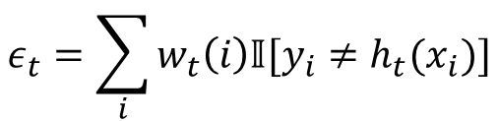
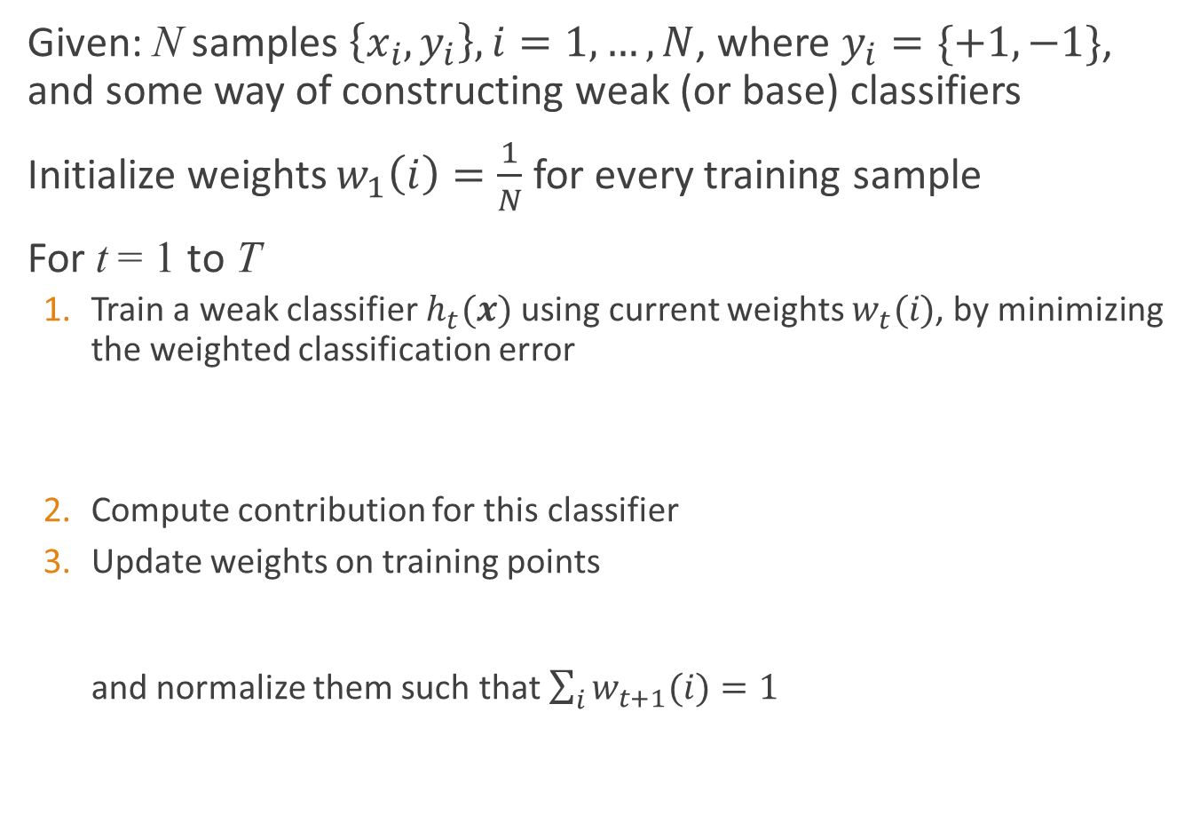


Adaboost Algorithm
Given: N samples $\left\{x_{i},y_{i}\right\}, i=1,…,N$, where $y_{i}=\{+1,−1\}$, and some way of constructing weak (or base) classifiers
Initialize weights $w_{1}\left(i\right)=\frac{1}{N}$ for every training sample
For t = 1 to T
  Train a weak classifier $h_{t}(x)$ using current weights $w_{t}(i)$, by minimizing the weighted classification error
  Compute contribution for this classifier
  Update weights on training points
  and normalize them such that $\sum_{i}{w_{t+1}(i)}=1$
$$ε_{t}=\sum_{i}{w_{t}\left(i\right)𝕀[y_{i}≠h_{t}(x_{i})]}$$
$$β_{t}=\frac{1}{2}\ln{\frac{{1−ε}_{t}}{ε_{t}}}$$
$$w_{t+1}\left(i\right)∝w_{t}\left(i\right)e^{−β_{t}y_{i}h_{t}(x_{i})}$$

Slide 7

Adaboost Algorithm
Output the final classifier
$$h\left[x\right]=sign\left[\sum_{t=1}^{T}{β_{t}h_{t}(x)}\right]$$

Slide 8
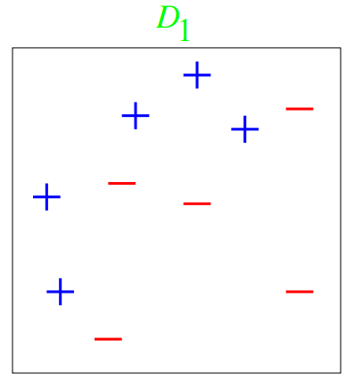

Example
10 data points and 2 features
The data points are clearly not linearly separable In the beginning, all data points have equal weights (the size of the data markers “+” or “-”)
Base classifier $h(⋅)$: either horizontal or vertical lines
  These ‘decision stumps’ are just trees with a single internal node, i.e., they classifying data based on a single attribute

Slide 9
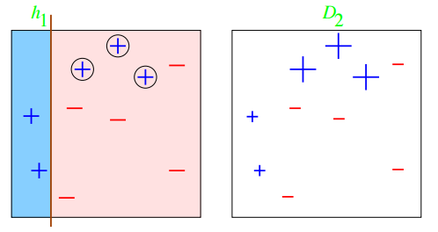

Example
Round 1: t = 1
3 misclassified (with circles): $ε_{1}=0.3→β_{1}=0.42$
Weights recomputed; the 3 misclassified data points receive larger weights

Slide 10
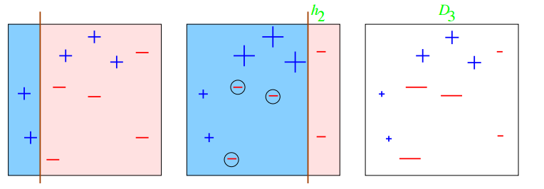

Example
Round 2: t = 2
3 misclassified (with circles): $ε_{2}=0.21→β_{2}=0.65$
  Note that $ε_{2}≠0.3$ as those 3 data points have weights less than 1/10
3 misclassified data points get larger weights
Data points classified correctly in both rounds have small weights

Slide 11
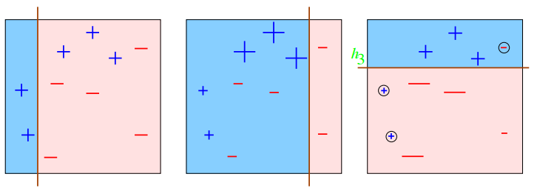

Example
Round 3: t = 3
3 misclassified (with circles): $ε_{3}=0.14→β_{3}=0.92$.
Previously correctly classified data points are now misclassified, but our error is low; what’s the intuition?
  Since they have been consistently classified correctly, this round’s mistake will hopefully not have a huge impact on the overall prediction

Slide 12
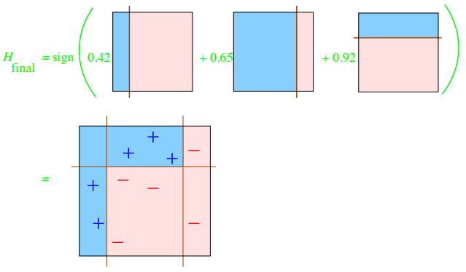
Example
Final classifier: combining 3 classifiers
All data points are now classified correctly!

Slide 13
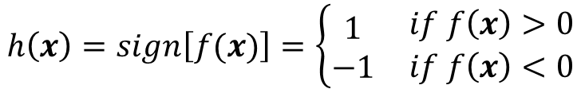
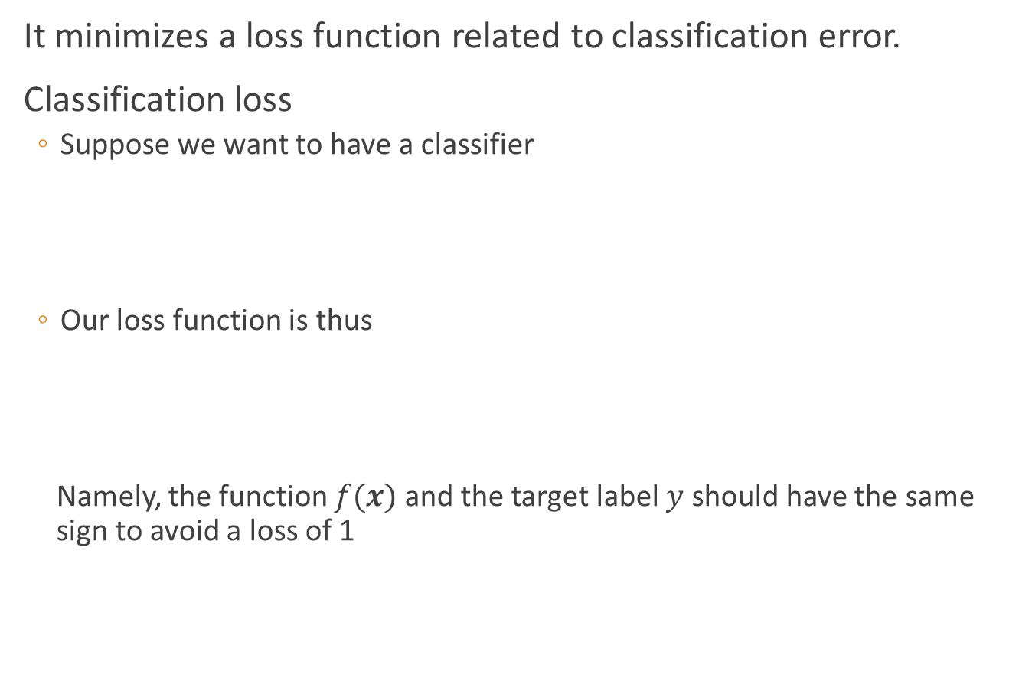
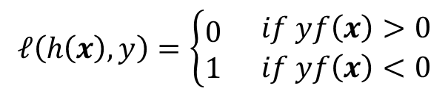
Why AdaBoost works?
It minimizes a loss function related to classification error.
Classification loss
  Suppose we want to have a classifier
  Our loss function is thus
  Namely, the function $f(x)$ and the target label $y$ should have the same sign to avoid a loss of 1
$$h\left(x\right)=sign\left[f(x)\right]=\left\{\begin{aligned}1 \\ −1\end{aligned}\right. \begin{matrix}if f\left(x\right)>0 \\ if f\left(x\right)<0\end{matrix}$$
$$ℓ\left(h\left(x\right),y\right)=\left\{\begin{aligned}0 \\ 1\end{aligned}\right. \begin{matrix}if yf\left(x\right)>0 \\ if yf\left(x\right)<0\end{matrix}$$

Slide 14
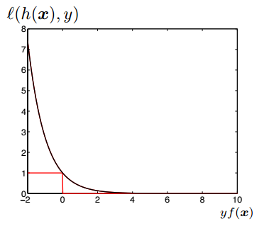
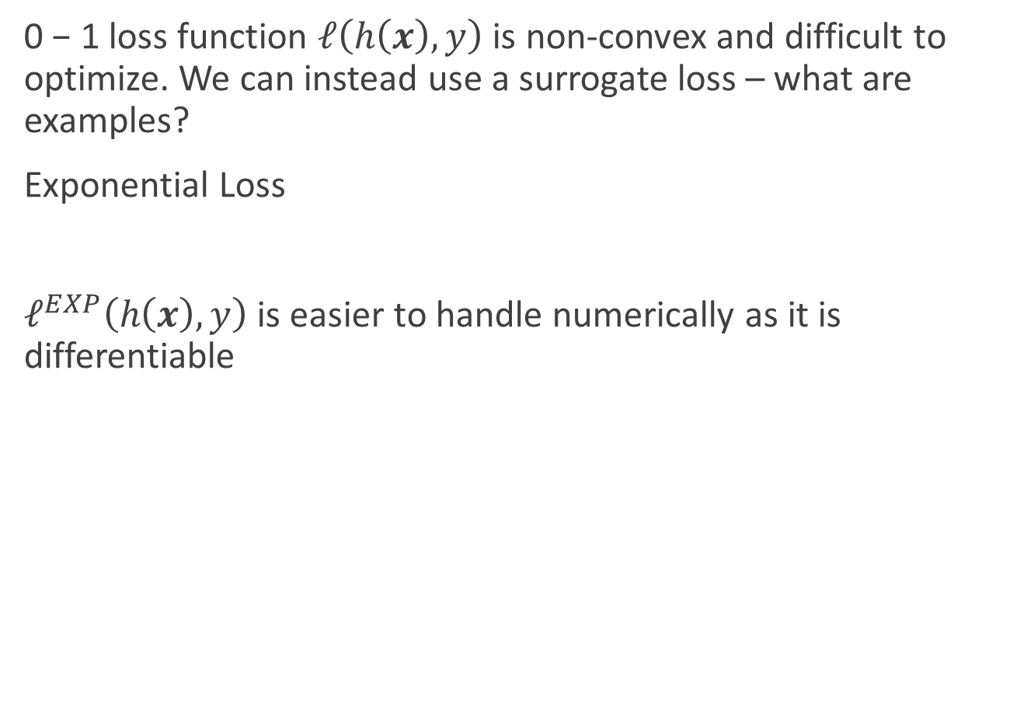

Surrogate loss
0 − 1 loss function $ℓ\left(h\left(x\right),y\right)$ is non-convex and difficult to optimize. We can instead use a surrogate loss – what are examples?
Exponential Loss
$ℓ^{EXP}\left(h\left(x\right),y\right)$ is easier to handle numerically as it is differentiable
$$ℓ^{EXP}\left(h\left(x\right),y\right)=e^{−yf(x)}$$

Slide 15
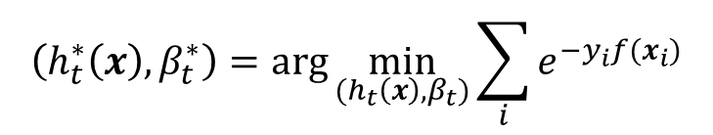
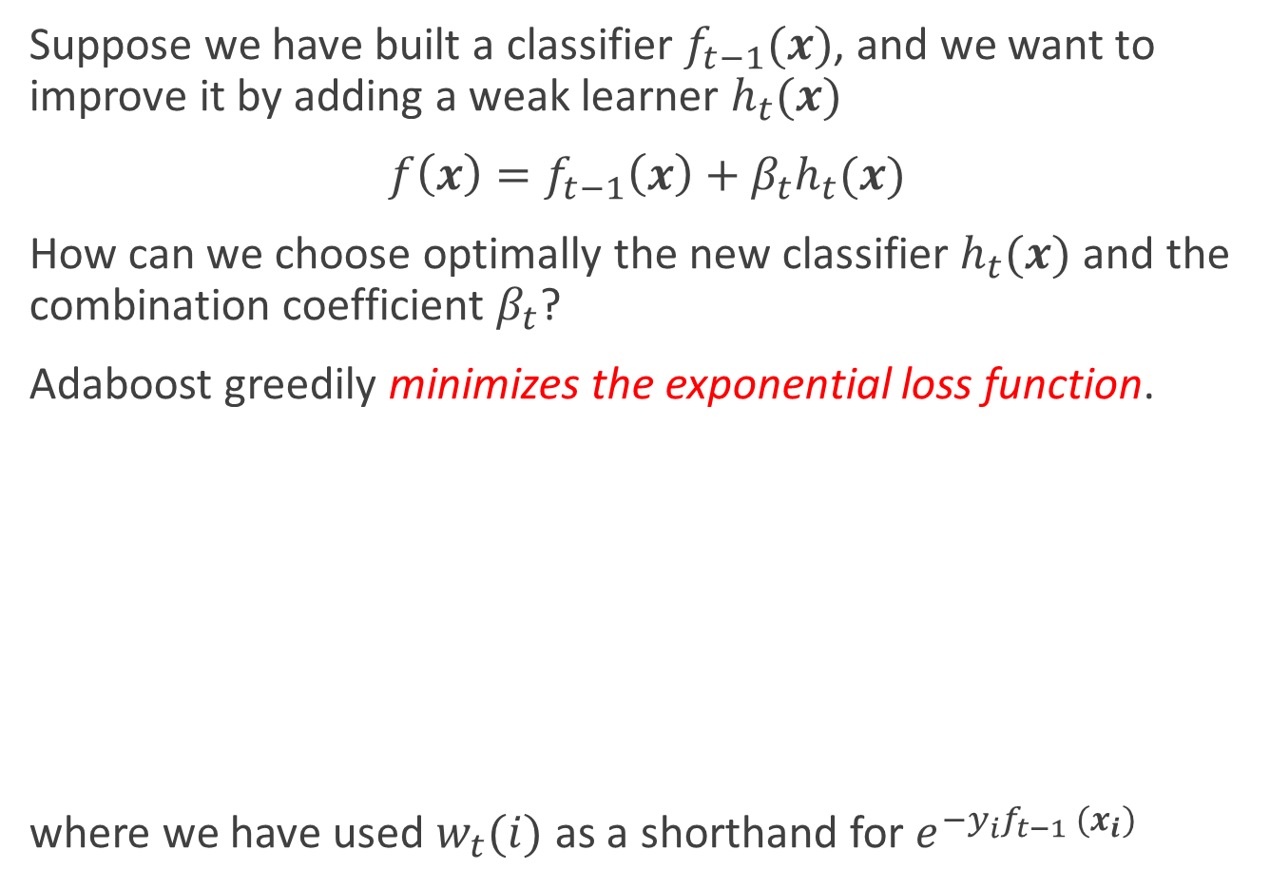
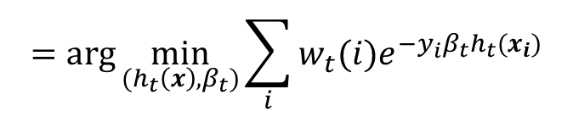
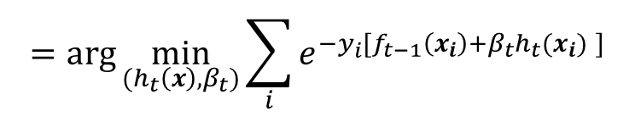
Choosing the t-th classifier
Suppose we have built a classifier $f_{t−1}(x)$, and we want to improve it by adding a weak learner $h_{t}(x)$
$f\left(x\right)=f_{t−1}\left(x\right)+β_{t}h_{t}(x)$
How can we choose optimally the new classifier $h_{t}(x)$ and the combination coefficient $β_{t}$?
Adaboost greedily minimizes the exponential loss function.
where we have used $w_{t}(i)$ as a shorthand for $e^{−y_{i}f_{t−1} (x_{i})}$
$$\left(h_{t}^{∗}\left(x\right),β_{t}^{∗}\right)=\arg{\min_{(h_{t}\left(x\right),β_{t})}{\sum_{i}{e^{−y_{i}f(x_{i})}}}}$$
$$=\arg{\min_{(h_{t}\left(x\right),β_{t})}{\sum_{i}{e^{−y_{i}[f_{t−1}\left(x_{i}\right)+β_{t}h_{t}(x_{i}) ]}}}}$$
$$=\arg{\min_{(h_{t}\left(x\right),β_{t})}{\sum_{i}{w_{t}(i)e^{−y_{i}β_{t}h_{t}(x_{i})}}}}$$

Slide 16


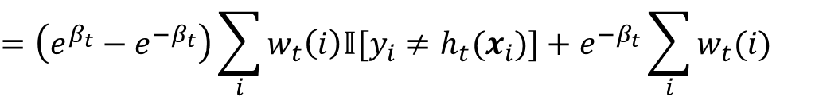
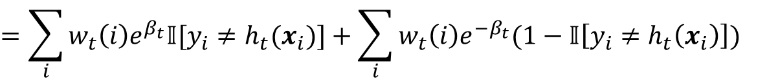
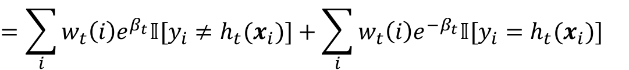
The new classifier
We can decompose the weighted loss function into two parts
We have used the following properties to derive the above
  $y_{i}h_{t}(x_{i})$ is either 1 or -1 as $h_{t}(x_{i})$ is the output of a binary classifier
  The indicator function $𝕀[y_{i}=h_{t}(x_{i})]$ is either 0 or 1, so it equals $1−𝕀\left[y_{i}≠h_{t}\left(x_{i}\right)\right]$
$$\sum_{i}{{w_{t}(i)e}^{−y_{i}β_{t}h_{t}(x_{i})}}$$
$$=\sum_{i}{{w_{t}\left(i\right)e}^{β_{t}}𝕀[y_{i}≠h_{t}(x_{i})]}+\sum_{i}{{w_{t}\left(i\right)e}^{{−β}_{t}}𝕀[y_{i}=h_{t}(x_{i})]}$$
$$=\sum_{i}{{w_{t}\left(i\right)e}^{β_{t}}𝕀[y_{i}≠h_{t}(x_{i})]}+\sum_{i}{{w_{t}\left(i\right)e}^{{−β}_{t}}(1−𝕀\left[y_{i}≠h_{t}\left(x_{i}\right)\right])}$$
$$=\left(e^{β_{t}}−e^{−β_{t}}\right)\sum_{i}{w_{t}\left(i\right)𝕀[y_{i}≠h_{t}(x_{i})]}+e^{−β_{t}}\sum_{i}{w_{t}(i)}$$

Slide 17
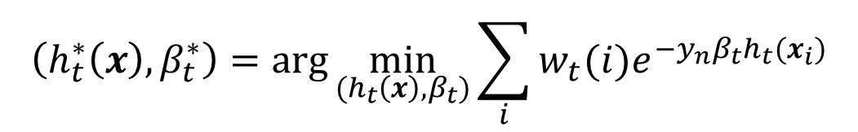

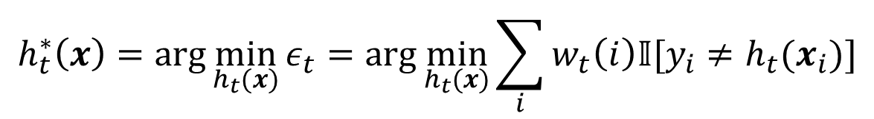

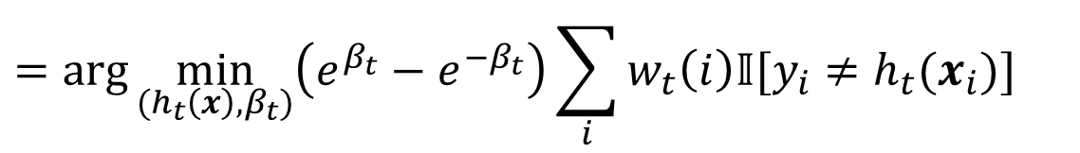
Finding the optimal weak learner
Summary
What term(s) must we optimize to choose $h_{t}\left(x_{i}\right)$?
Minimize weighted classification error as noted in step 1 of Adaboost!
$$\left(h_{t}^{∗}\left(x\right),β_{t}^{∗}\right)=\arg{\min_{(h_{t}\left(x\right),β_{t})}{\sum_{i}{w_{t}(i)e^{−y_{n}β_{t}h_{t}(x_{i})}}}}$$
$$=\arg{\min_{(h_{t}\left(x\right),β_{t})}\left(e^{β_{t}}−e^{−β_{t}}\right)\sum_{i}{w_{t}\left(i\right)𝕀[y_{i}≠h_{t}(x_{i})]}}$$
$$+e^{−β_{t}}\sum_{i}{w_{t}(i)}$$
$$h_{t}^{∗}\left(x\right)=\arg{\min_{h_{t}(x)}{ε_{t}}}=\arg{\min_{h_{t}(x)}{\sum_{i}{w_{t}\left(i\right)𝕀[y_{i}≠h_{t}(x_{i})]}}}$$

Slide 18

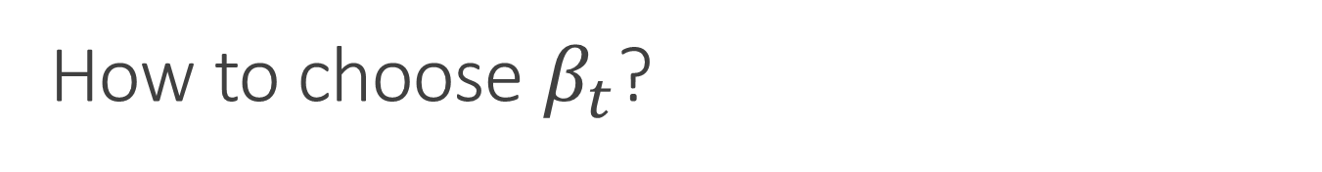
How to choose $β_{t}$?
Summary
What term(s) must we optimize?
We need to minimize the entire objective function with respect to $β_{t}$!
$$\left(h_{t}^{∗}\left(x\right),β_{t}^{∗}\right)=\arg{\min_{(h_{t}\left(x\right),β_{t})}{\sum_{i}{w_{t}(i)e^{−y_{n}β_{t}h_{t}(x_{i})}}}}$$
$$=\arg{\min_{(h_{t}\left(x\right),β_{t})}\left(e^{β_{t}}−e^{−β_{t}}\right)\sum_{i}{w_{t}\left(i\right)𝕀[y_{i}≠h_{t}(x_{i})]}}$$
$$+e^{−β_{t}}\sum_{i}{w_{t}(i)}$$

Slide 19


How to choose $β_{t}$?
Summary
What term(s) must we optimize?
We can do this by taking derivative with respect to $β_{t}$ , setting to zero, and solving for $β_{t}$ . After some calculation and using $\sum_{i}{w_{t}\left(i\right)=1}$, we find:
which is precisely step 2 of Adaboost!
$$\left(h_{t}^{∗}\left(x\right),β_{t}^{∗}\right)=\arg{\min_{(h_{t}\left(x\right),β_{t})}{\sum_{i}{w_{t}(i)e^{−y_{n}β_{t}h_{t}(x_{i})}}}}$$
$$=\arg{\min_{(h_{t}\left(x\right),β_{t})}\left(e^{β_{t}}−e^{−β_{t}}\right)\sum_{i}{w_{t}\left(i\right)𝕀[y_{i}≠h_{t}(x_{i})]}}$$
$$+e^{−β_{t}}\sum_{i}{w_{t}(i)}$$
$$β_{t}^{∗}=\frac{1}{2}\ln{\frac{1−ε_{t}}{ε_{t}}}$$

Slide 20
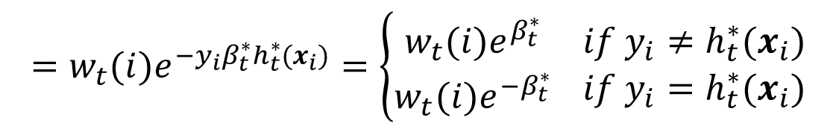
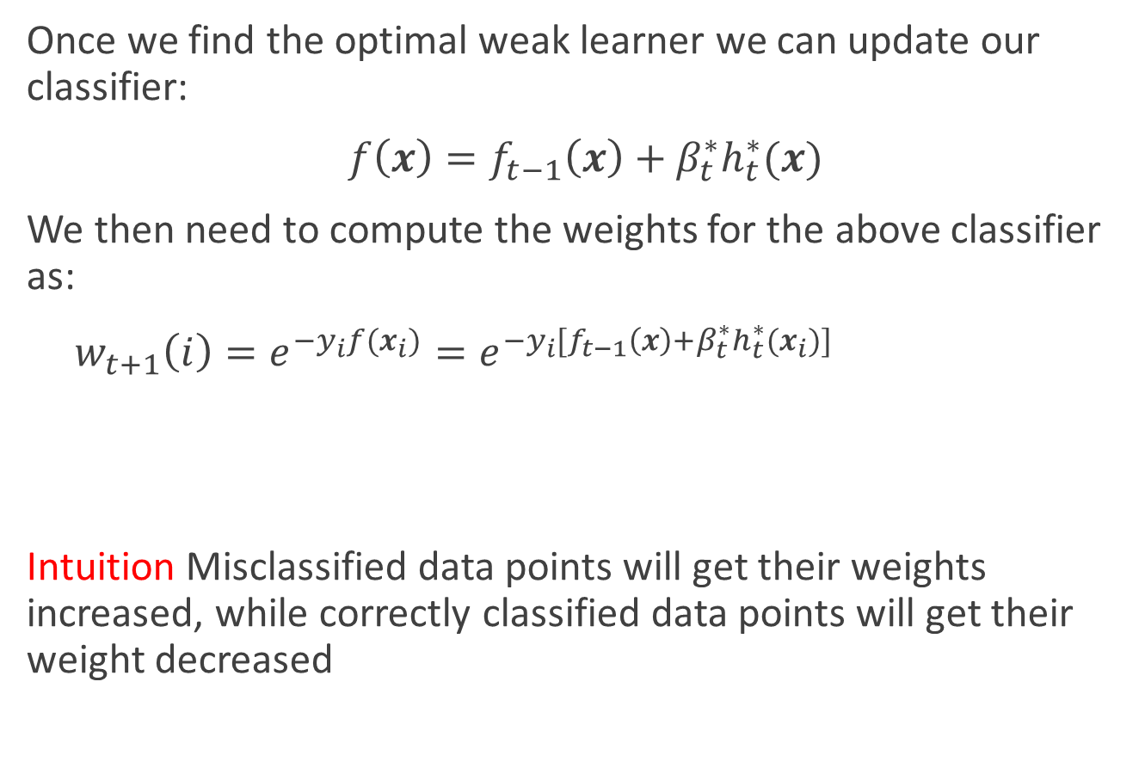
Updating the weights
Once we find the optimal weak learner we can update our classifier:
$f\left(x\right)=f_{t−1}\left(x\right)+β_{t}^{∗}h_{t}^{∗}(x)$
We then need to compute the weights for the above classifier as:
$w_{t+1}\left(i\right)=e^{−y_{i}f(x_{i})}=e^{−y_{i}[f_{t−1}\left(x\right)+β_{t}^{∗}h_{t}^{∗}(x_{i})]}$
Intuition Misclassified data points will get their weights increased, while correctly classified data points will get their weight decreased
$$=w_{t}(i)e^{−y_{i}β_{t}^{∗}h_{t}^{∗}(x_{i})}=\left\{\begin{aligned}w_{t}(i)e^{β_{t}^{∗}} \\ w_{t}(i)e^{{−β}_{t}^{∗}}\end{aligned}\right. \begin{matrix}if y_{i}≠h_{t}^{∗}(x_{i}) \\ if y_{i}=h_{t}^{∗}(x_{i})\end{matrix}$$

Slide 21
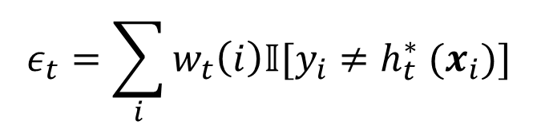
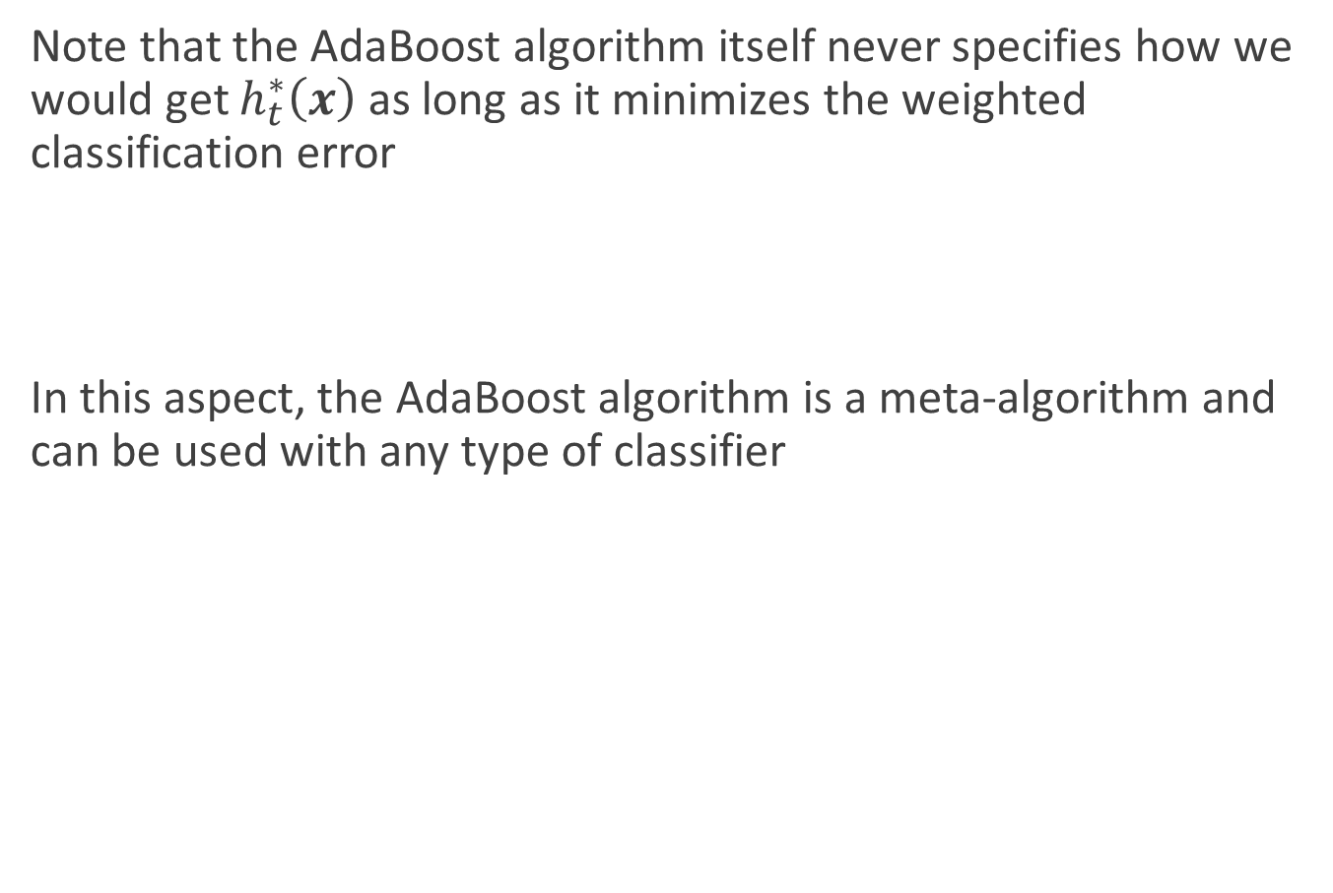
Meta-Algorithm
Note that the AdaBoost algorithm itself never specifies how we would get $h_{t}^{∗}\left(x\right)$ as long as it minimizes the weighted classification error
In this aspect, the AdaBoost algorithm is a meta-algorithm and can be used with any type of classifier
$$ε_{t}=\sum_{i}{w_{t}\left(i\right)𝕀[y_{i}≠h_{t}^{∗} (x_{i})]}$$

Slide 22
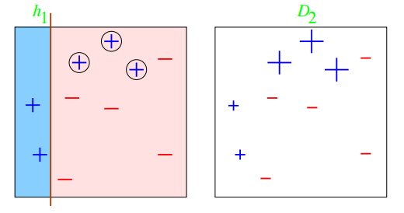
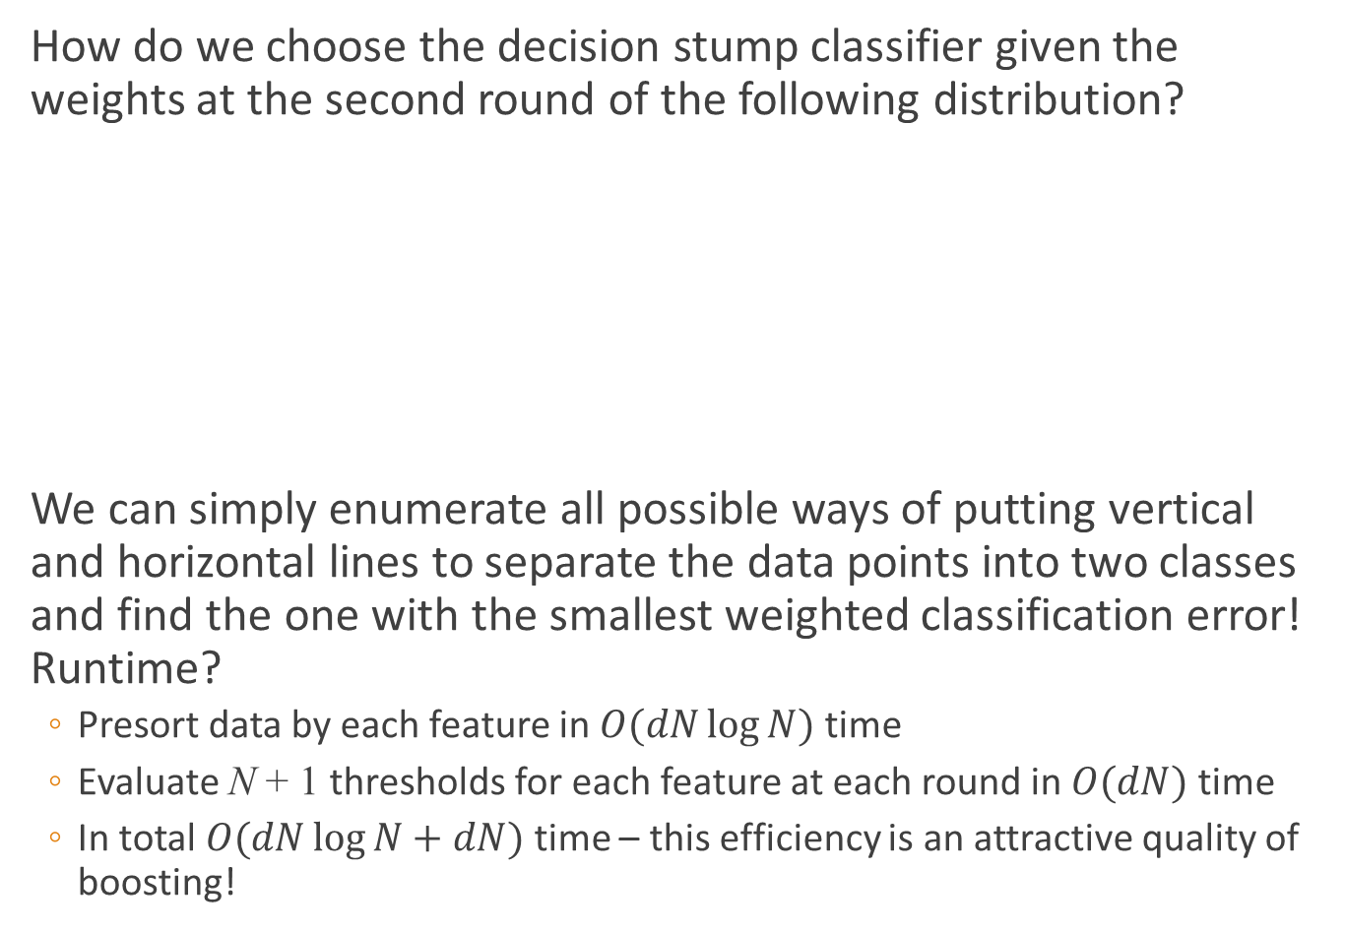
E.g., Decision Stumps
How do we choose the decision stump classifier given the weights at the second round of the following distribution?
We can simply enumerate all possible ways of putting vertical and horizontal lines to separate the data points into two classes and find the one with the smallest weighted classification error! Runtime?
  Presort data by each feature in $O(dN\log{N})$ time
  Evaluate N + 1 thresholds for each feature at each round in $O(dN)$ time
  In total $O(dN\log{N}+dN)$ time – this efficiency is an attractive quality of boosting!

Slide 23
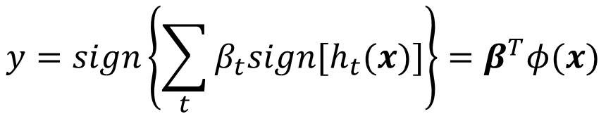
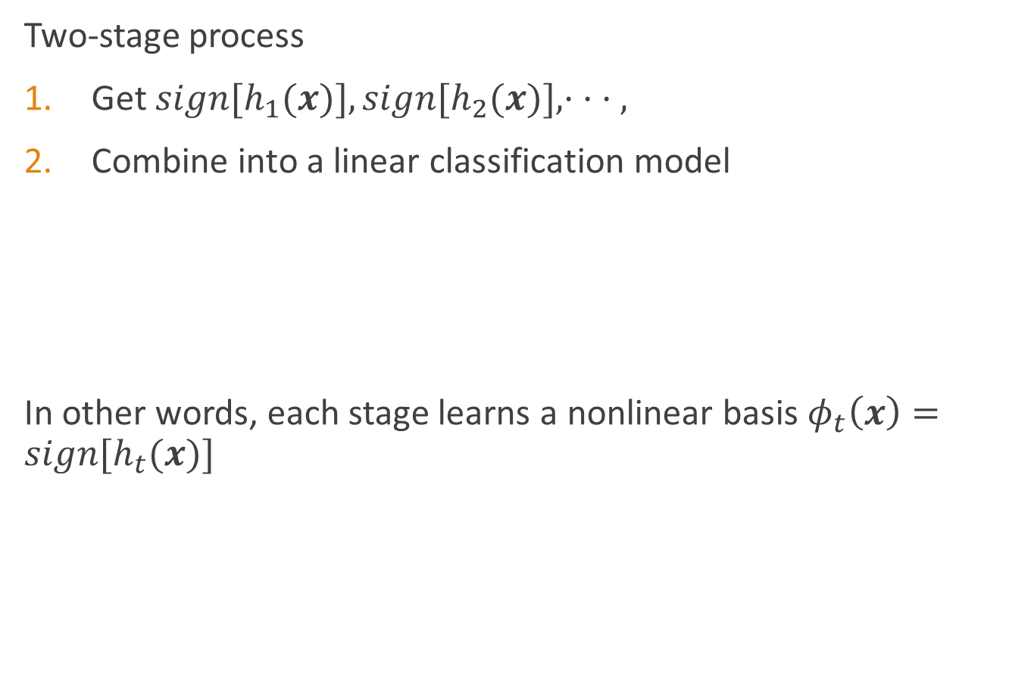
Interpreting boosting as learning nonlinear basis
Two-stage process
Get $sign[h_{1}(x)], sign[h_{2}(x)],· · · ,$
Combine into a linear classification model
In other words, each stage learns a nonlinear basis $φ_{t}\left(x\right)=sign[h_{t}(x)]$
$$y=sign\left\{\sum_{t}{β_{t}sign[h_{t}(x)]}\right\}=β^{T}φ(x)$$

Slide 24
Adaboost in face detection
Haar-like features
  Compute the difference between the sums of pixels within two (or more) rectangular regions

Slide 25
Adaboost in face detection
VJ face detector
  The first and second features selected by AdaBoost.
Notes:
The first feature measures the difference in intensity between the region of the eyes and a region across the upper cheeks. The feature capitalizes on the observation that the eye region is often darker than the cheeks. The second feature compares the intensities in the eye regions to the intensity across the bridge of the nose.

Slide 26
Adaboost in face detection
Rejection cascade
  Each node represents a multitree boosted classifier ensemble tuned to rarely miss a true face while rejecting a possibly small fraction of nonfaces

Slide 27
Adaboost in face detection

Slide 28
Bagging
“Bootstrap Aggregation”
Create Bootstrap samples of a training set using sampling with replacement.
Each bootstrap sample is used to train a different component of base classifier
Classification is done by plurality voting
Regression is done by averaging
Works for unstable classifiers
  Neural Networks
  Decision Trees

Slide 29
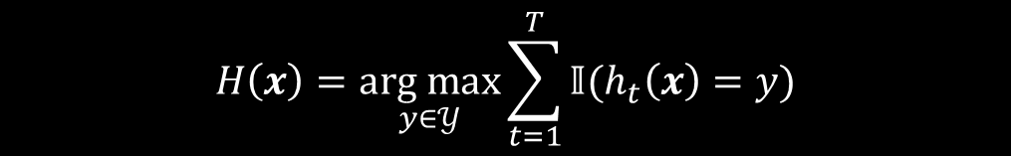
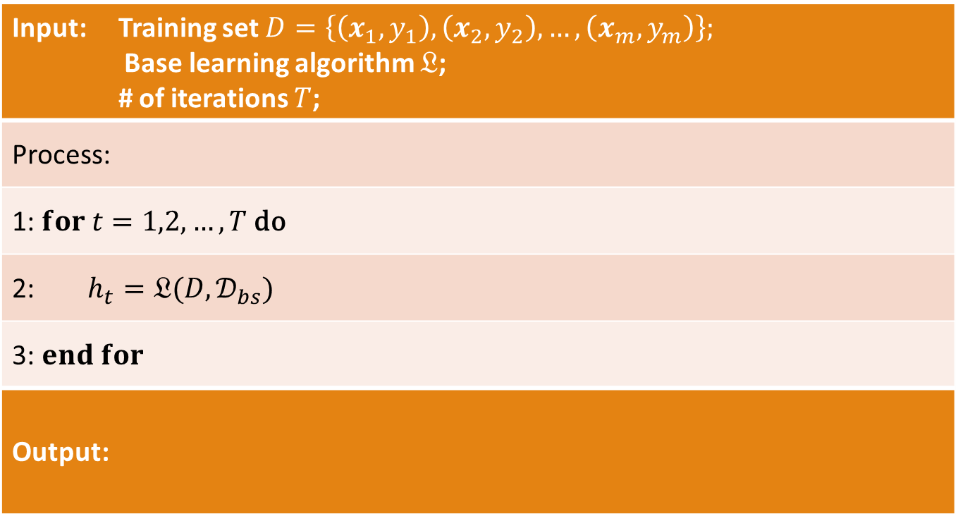
Bagging
Input: Training set $D=\left\{\left(x_{1},y_{1}\right),\left(x_{2},y_{2}\right),…,\left(x_{m},y_{m}\right)\right\};$ Base learning algorithm $𝔏$; # of iterations $T$;
Process:
1: $for t=1,2,…,T \text{do}$
2: $h_{t}=𝔏(D,𝒟_{bs})$
3: $end for$
Output:
$$H\left(x\right)=\underset{y∈𝒴}{arg max}{\sum_{t=1}^{T}{𝕀(h_{t}\left(x\right)=y)}}$$

Slide 30
Random forest
A variant of bagging proposed by Breiman
It’s a general class of ensemble building methods using a decision tree as base classifier.
Classifier consisting of a collection of tree-structure classifiers.
Each tree grown with a random vector V_{k} where k = 1,…L are independent and statistically distributed.
Each tree cast a unit vote for the most popular class at input x
Notes:
每棵树的训练集都是不同的，而且里面包含重复的训练样本
如果每个样本的特征维度为M，指定一个常数m<<M，随机地从M个特征中选取m个特征子集，每次树进行分裂时，从这m个特征中选择最优的
每棵树都尽最大程度的生长，并且没有剪枝过程
Leo Breiman was born in New York City on Jan. 27, 1928, the only child of Eastern European immigrants Max and Lena Breiman. His father was a tailor and sewing machine operator, and his mother was a housewife.
n 1949, he earned a degree in physics from the California Institute of Technology. He then decided to study philosophy at Columbia University, but was persuaded to return to mathematics when the head of the philosophy department confided that his two best Ph.D.s couldn't find jobs. He received a master's degree in mathematics from Columbia in 1950,
After earning his Ph.D. from UC Berkeley in 1954, he was hired to teach probability theory at UCLA. In a 2001 interview with the journal Statistical Science, he said that while at UCLA, he concluded that math education for children was "all wrong because they wound up thinking of mathematics as an awful, boring subject that had nothing to do with the everyday world around them.“
So, he volunteered to teach math to two 5th grade classes, one of them for emotionally disturbed youngsters.
Following his resignation from UCLA, he spent years as a statistical consultant, developing and using new statistical methods to predict such matters as patterns of traffic on the freeways, bottlenecks in the court system and next-day ozone levels in the Los Angeles basin.

Slide 31
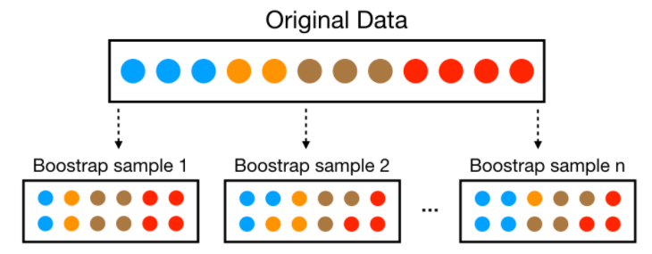
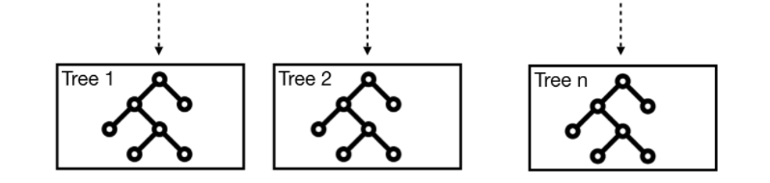
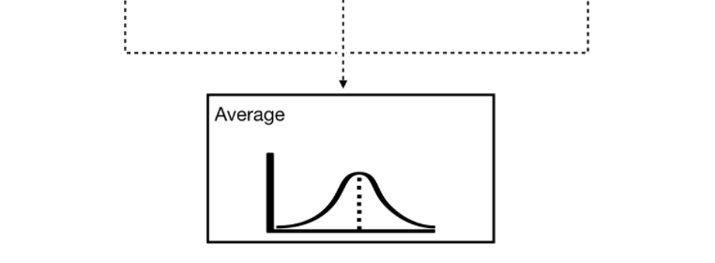
Random forest
1. Sample records with replacement (aka "bootstrap" the training data)
  Sampling is the process of selecting a subset of items from a vast collection of items.
  Bootstrap = Sampling with replacement. It means a data point in a drawn sample can reappear in future drawn samples as well.
2. Fit an overgrown tree to each resampled data set
3. Average predictions

Slide 32
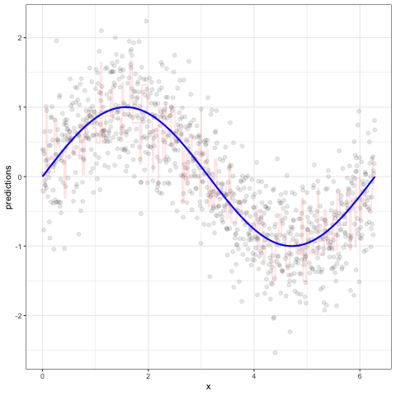

Random forest
our average prediction error reduces
As we add more trees...

Slide 33

Random forest
Random forest is identified as a collection of decision trees. Each tree estimates a classification, and this is called a “vote”. Ideally, we consider each vote from every tree and chose the most voted classification (Majority-Voting).
Random Forest follow the same bagging process as the decision trees but each time a split is to be performed, the search for the split variable is limited to a random subset of $m$ of the $p$ attributes (variables or features) aka Split-Attribute Randomization :
classification trees: $m = \sqrt{p}$
regression trees: $m = p/3$
Random Forests produce many unique trees.

Slide 34


Random forest

Slide 35

Bagging vs Random Forest
Bagging introduces randomness into the rows of the data.
Random forest introduces randomness into the rows and columns of the data
Combined, this provides a more diverse set of trees that almost always lowers our prediction error.
Split-Attribute Randomization : Prediction Error

Slide 36
Random Forest
Strengths
  Competitive performance
  Remarkably good “out-of-the box” (very little tuning required)
  Build-in validation set (don’t need to sacrifice data for extra validation)
  Typically doesn’t overfit
  Robust to outliers
  Handles missing data
  Provide automatic feature selection
  Minimal preprocessing required
Weaknesses
  Although accurate, often cannot compete with the accuracy of advance boosting algorithms
  Can become slow on large data sets
  Less interpretable

Slide 37
Why does bagging work ?
Main reason for error in learning is due to noise ,bias and variance.
Noise is error by the target function
Bias is where the algorithm can not learn the target.
Variance comes from the sampling, and how it affects the learning algorithm
Bagging algorithm minimizes these errors
Averaging over bootstrap samples can reduce error from variance especially in case of unstable classifiers

Slide 38

Methods for constructing ensembles
An ensemble may work better than a single classifier

Slide 39



Methods for constructing ensembles
Suppose there are T base learners: $\{h_{1},h_{2},…,h_{T}\}$. Denote $h_{i}(x)$ the output of $h_{i}$ with respect to the sample x
Averaging
  Simple averaging
  Weighted averaging
$$H\left(x\right)=\frac{1}{T}\sum_{i=1}^{T}{h_{i}(x)}$$
$$H\left(x\right)=\sum_{i=1}^{T}{w_{i}h_{i}(x)}$$
$$w_{i}≥0, \sum_{i=1}^{T}{w_{i}}=1$$

Slide 40




Methods for constructing ensembles
Suppose there are N classes $\{c_{1},c_{2},…,c_{N}\}$. Denote $(h_{i}^{1}\left(x\right);h_{i}^{2}\left(x\right);…;h_{i}^{N}\left(x\right))$ the output of classifier $h_{i}$ when classifying sample $x$. $h_{i}^{j}\left(x\right)$ is the output of $h_{i}$ on class $c_{j}$.
Voting
  Majority voting
  Plurality voting
  Weighted voting
$$H\left(x\right)=\left\{\begin{aligned}c_{j}, if \sum_{i=1}^{T}{h_{i}^{j}\left(x\right)}>0.5\sum_{k=1}^{N}{\sum_{i=1}^{T}{h_{i}^{k}(x)}} \\ reject, otherwise \end{aligned}\right.$$
$$H\left(x\right)=c_{\arg{\max_{j}{\sum_{i=1}^{T}{h_{i}^{j}(x)}}}}$$
$$H\left(x\right)=c_{\arg{\max_{j}{\sum_{i=1}^{T}{{w_{i}h}_{i}^{j}(x)}}}}$$

Slide 41

Methods for constructing ensembles
Input: Training set $D=\left\{\left(x_{1},y_{1}\right),\left(x_{2},y_{2}\right),…,\left(x_{m},y_{m}\right)\right\};$ Base learning algorithm $𝔏_{1},𝔏_{2},…,𝔏_{T}$; Meta-learning (stacking) algorithm $𝔏$;
Process:
1: $for t=1,2,…,T \text{do}$
2: $h_{t}=𝔏_{t}(D)$;
3: $end for$
4: $D^{′}=∅$
5: $for i=1,2,…,m \text{do}$
6: $for t=1,2,…,T \text{do}$
7: $z_{it}=h_{t}(x_{i})$;
8: $end for$
9: $D^{′}=D′⋃(\left(z_{i1},z_{i2},…,z_{iT}\right),y_{i})$;
10: $end for$
11: $h^{′}=𝔏(D′)$
Output: $H\left(x\right)=h′(h_{1}\left(x\right),h_{2}\left(x\right),…,h_{T}(x))$
Stacking

